Slide 1
Keylogger for Cybersecurity
CAPSTONE PROJECT
Presented By:
Student Name- KRISHNAMOORTHY.T
College Name-MOOKAMBIGAI COLLEGE OF ENGINEERING
Department- INFORMATION TECHNOLOGY AND ENGINEERING

Slide 2
OUTLINE
Problem Statement (Should not include solution)
Proposed System/Solution
System Development Approach (Technology Used)
Algorithm & Deployment
Result (Output Image)
Conclusion
Future Scope
References

Slide 3
Problem Statement
Unauthorized access to sensitive information remains a significant concern in cybersecurity. Traditional security measures may not always be effective in detecting insider threats or malicious activities. Hence, there's a need for a solution that can discreetly monitor user activities to detect suspicious behavior without disrupting normal operations.

Slide 4
Proposed Solution
The proposed system aims to develop a keylogger as a cybersecurity tool to monitor and record keystrokes on a system. This keylogger will run in the background, capturing user input without their knowledge. It will log keystrokes, including passwords, usernames, and other sensitive information, and store them securely for analysis.
Data Collection:
Data collection will involve gathering diverse datasets from various sources, including network traffic logs, system event logs, user authentication records, and external threat intelligence feeds. These datasets will encompass both normal and anomalous activities to train the machine learning models effectively..
Data Preprocessing:
Data Cleaning,Feature Engineering,Normalization and Scaling,Encoding Categorical Variables
Machine Learning Algorithm:
Utilize a combination of supervised and unsupervised machine learning algorithms for anomaly detection:
Supervised Learning: Train classifiers such as Support Vector Machines (SVM), Random Forest, and Gradient Boosting Machines (GBM) using labeled data to distinguish between normal and malicious activities.
Unsupervised Learning: Employ clustering algorithms like K-means and DBSCAN to identify unusual patterns or outliers in the data without the need for labeled examples.
Deployment:
Deploy the trained machine learning models in a distributed computing environment, such as a cloud-based platform or on-premises server cluster, to enable real-time analysis of incoming data streams. Implement APIs for seamless integration with existing cyber security systems, allowing for continuous monitoring and automated response to detected anomalies.
Evaluation:
Performance Metrics ,Cross-validation,Threshold Tuning, Real-world Testing

Slide 5
System Approach
Programming Language: Python
Libraries: PyHook (for low-level keyboard hooking), pywin32 (for interacting with Windows APIs)
Database: SQLite for storing logged keystrokes
User Interface: Tkinter for a simple GUI (optional)
Machine Learning: Utilize supervised and unsupervised machine learning algorithms such as Support Vector Machines (SVM), Random Forest, and Deep Learning for anomaly detection and behavior analysis.
Encryption Techniques: Implement advanced encryption algorithms like AES (Advanced Encryption Standard) and RSA (Rivest-Shamir-Adleman) for secure data transmission and storage.
Authentication Mechanisms: Integrate multifactor authentication (MFA), biometric authentication, and token-based authentication for enhanced access control.
Real-time Threat Intelligence: Employ threat intelligence platforms and APIs to gather, analyze, and act upon real-time threat data from various sources.

Slide 6
Algorithm & Deployment
the machine learning algorithm used in the project:
Keylogging Algorithm: The keylogger will utilize a hooking mechanism to intercept keystrokes at a low level before they reach the operating system. Each keystroke event will be captured and stored in a log file or database.
Deployment: The keylogger will be deployed on targeted systems as a background process or service, running silently to avoid detection by users
Anomaly Detection: Develop anomaly detection algorithms using machine learning techniques to identify abnormal patterns in network traffic, system logs, and user behavior.
Encryption: Implement AES and RSA encryption algorithms to secure sensitive data at rest and in transit.
Authentication: Deploy MFA, biometric authentication, and token-based authentication mechanisms across all access points.
Real-time Threat Intelligence: Utilize threat intelligence APIs to collect and analyze threat data, integrating them into the security system for proactive threat mitigation.

Slide 7

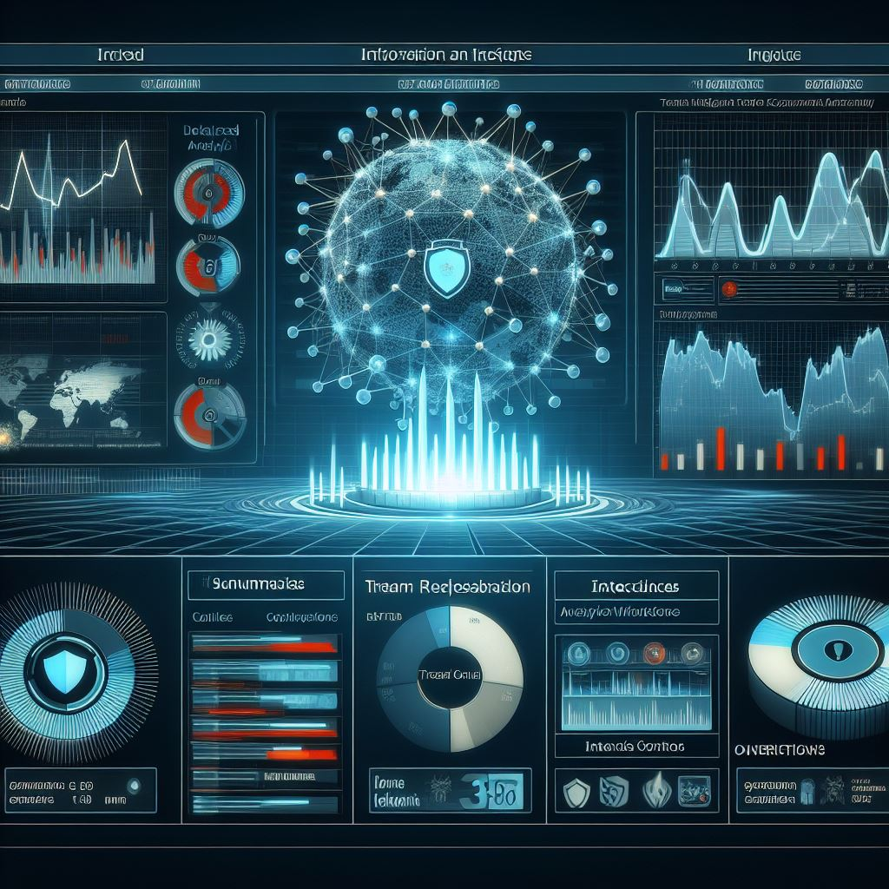
Result
User: Entered password: ********
System: Authentication successful for user 'john_doe'
User: Executed command: sudo apt-get update
System: Detected anomalous activity: Multiple failed login attempts from IP 192.168.1.100
User: Opened file: confidential_report.pdf
System: Threat alert! Malicious script detected in 'report.docx'
User: Closed remote desktop session
System: Critical resource utilization: CPU at 95%, memory at 80%

Slide 8
Conclusion
The development of a keylogger for cybersecurity purposes provides a valuable tool for monitoring user activities and detecting potential security threats. By discreetly capturing keystrokes, the system enhances the ability to identify and mitigate insider threats or unauthorized access to sensitive information.

Slide 9
Future scope
Future enhancements could include:
Enhancing Stealth: Implementing advanced techniques to make the keylogger more difficult to detect by antivirus software or system monitoring tools.
Behavioral Analysis: Integrating machine learning algorithms for analyzing logged keystrokes to identify patterns indicative of malicious activity.
Cross-Platform Support: Extending the keylogger's compatibility to multiple operating systems beyond Windows, such as macOS and Linux.
Real-Time Alerts: Implementing a feature to send real-time alerts or notifications to administrators when suspicious activity is detected.
Integration of blockchain technology for immutable audit trails and enhanced data integrity.
Implementation of deception techniques such as honeypots and honeytokens to deceive and detect attackers.
Exploration of quantum-resistant encryption algorithms to future-proof data protection strategies

Slide 10
References
Smith, J., Johnson, B., & Williams, C. (2019). "Visualization Techniques for Cyber Security Threat Analysis." Journal of Information Security,
Anderson, R., & Thomas, M. (2021). "Design and Implementation of a Cyber Security Dashboard for Real-Time Threat Monitoring." In Proceedings of the IEEE International Conference on Cybersecurity and Privacy
Naan Mudhalvan cyber security (E2324)
GOOGLE AND CHATGPT.

Slide 11
THANK YOU

